Slide 1
Making more data out of the data you already have
DATA AUGMENTATION
Seven transformations, where each one helps, and the point past which each one starts lying to your model.
Notes:
Open by reminding them where the last session ended: the CNN improved validation accuracy, but training accuracy was still well above it. That gap is overfitting, and this session is about closing it without going out and collecting more data.

Slide 2
The CNN helped. It did not fix the gap.
WHERE WE LEFT OFF
What improved
What did not
Swapping the dense network for a convolutional one raised validation accuracy. Local filters and shared weights were the right prior for images.
Training accuracy is still well above validation accuracy. The model knows its training images; it does not yet know the category. Also inconsistent.
That gap has a name — overfitting — and when it persists after you have chosen a sensible architecture, the problem has usually moved from the model to the data.
Notes:
Make the diagnostic point explicitly: a large train-validation gap tells you the model has capacity to spare and not enough variety to spend it on. Adding layers will make it worse. This is the moment to look at the dataset instead.

Slide 3
Get more data, or get more out of the data you have.
TWO WAYS OUT
Collect and label more
Augment what you have
Always the better answer, and usually the unaffordable one. Labelling costs money, instrument time or a specialist's attention — sometimes all three.
Change each image in ways that leave its label true. One photograph becomes dozens of training examples, for the cost of a few lines of code.
The second works because of what you already know about images: a marble photographed from a little further left is still a marble. You are handing the network a fact it would otherwise have to discover from examples.
Notes:
Worth framing augmentation as encoding prior knowledge rather than as a trick. Every augmentation is a statement of the form "this transformation does not change the label". That is domain knowledge you have and the network does not, and the whole of the next section is about getting those statements right.

Slide 4
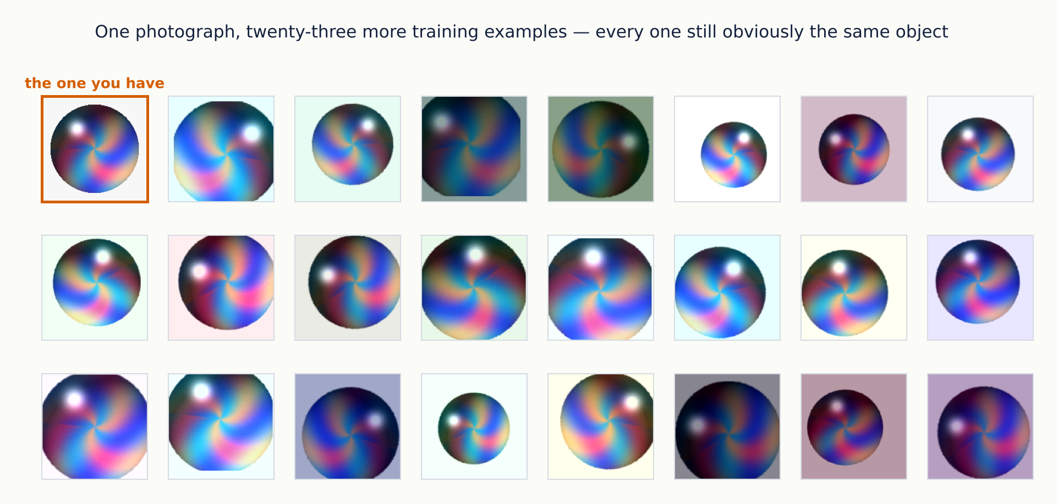
One image, twenty-four training examples
THE IDEA IN ONE PICTURE
Notes:
Point out that none of these required a label. The label came with the original and survives every transformation on the slide — that is the only reason this is legitimate. Ask the class to spot which operations they can identify: rotation, zoom, shift, flip, brightness, colour. Each gets its own slide next.

Slide 5
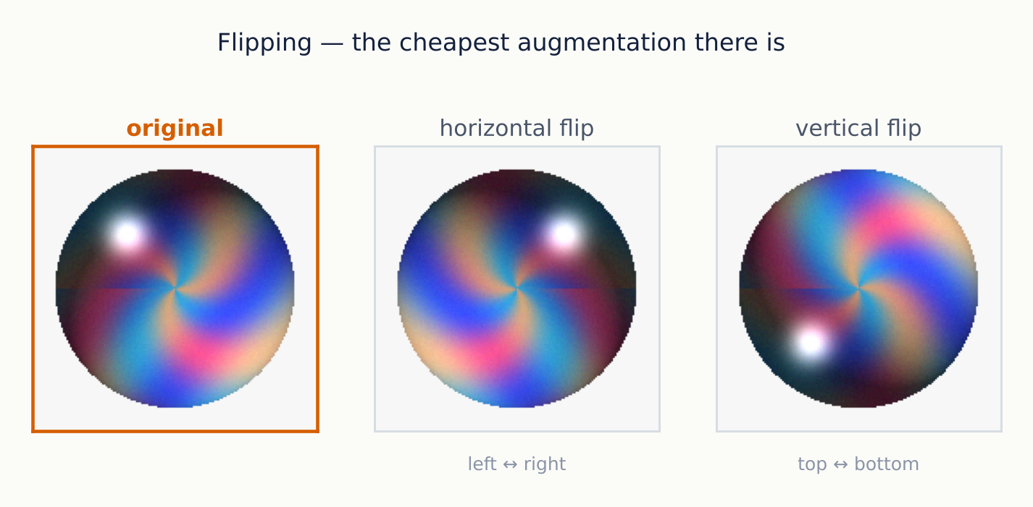
Turn the sheet of paper over
METHOD 1 OF 7 · FLIPPING
Free, instant, and doubles the dataset — when it is valid. Horizontal flipping suits most natural scenes. Vertical flipping rarely does, because gravity means photographs have a top and a bottom.
Notes:
The NVIDIA deck has a good example here: most American Sign Language signs mirror depending on whether the signer is right- or left-handed, so a horizontal flip is a legitimate augmentation for that dataset. Text and digits are the opposite case — a flipped 2 is not a 2. Ask the class which of their own project images would survive a flip.

Slide 6
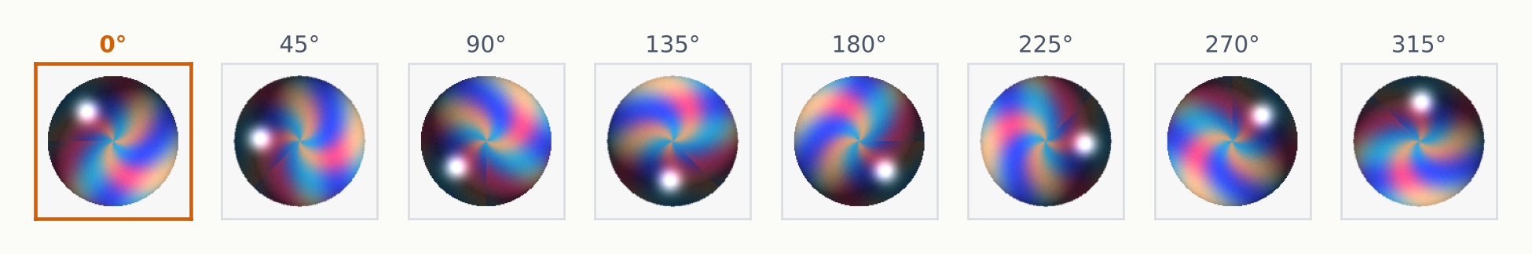
Spin the sheet instead of flipping it
METHOD 2 OF 7 · ROTATION
Small angles are almost always safe
Large angles need a reason
Nobody holds a camera perfectly level, and nobody signs or places a sample at exactly the same angle twice. Ten or fifteen degrees reflects reality.
A marble is fine at any angle. A hand sign at ninety degrees is not something your camera will ever see, so teaching the model to expect it wastes capacity.
Notes:
A micrograph or a satellite image genuinely has no preferred orientation, so full 360-degree rotation is correct there. A photograph of a person, a road scene or a hand sign has a strong up direction. The rule is to augment with the variation the deployed system will actually encounter, and no more.

Slide 7
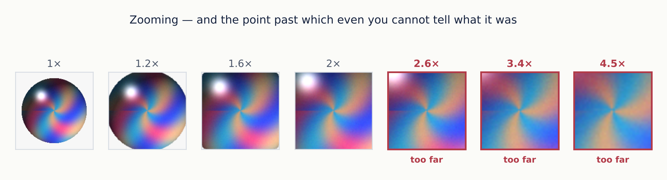
Bring the sheet closer to your face
METHOD 3 OF 7 · ZOOM
The first few are a marble photographed from closer. The last few are a coloured blur that is still labelled “marble” — and that is a lie you have added to your training set.
Notes:
This is the slide where the going-too-far idea first appears, and it is the most useful habit in the whole topic. The test is simple: sample some output from your augmentation pipeline and look at it. If you cannot tell what it is, neither can the network, and you have just taught it that noise belongs to this class.

Slide 8
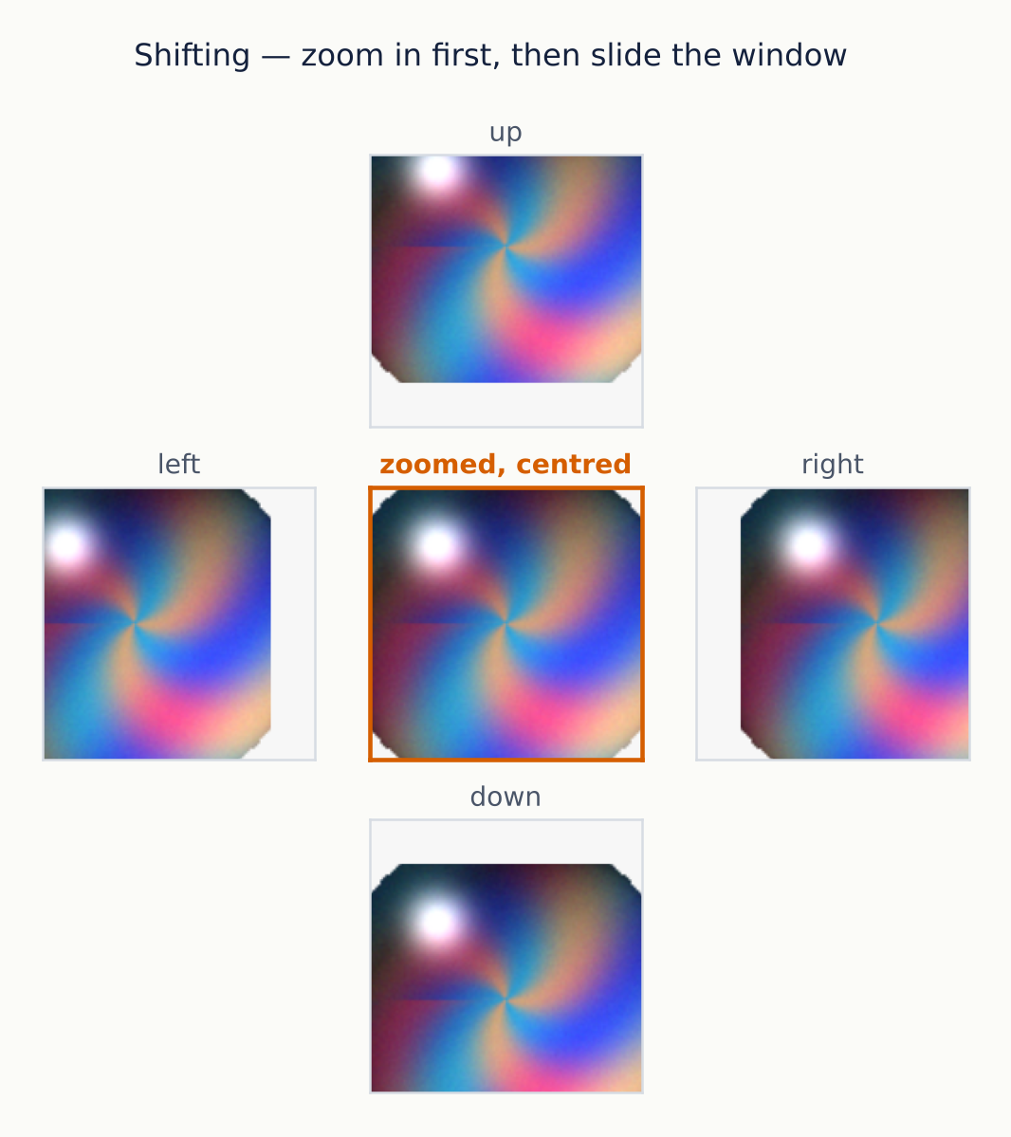
Slide the window around the subject
METHOD 4 OF 7 · WIDTH AND HEIGHT SHIFT
Zoom in first, then move the crop. The pixels outside the frame are still there, so shifting costs nothing and introduces no blank edges.
Also called translation
This is the same invariance that max pooling gives you inside the network, now taught from the data side as well. The two reinforce each other.
Shift without zooming first and you get a blank strip along one edge. Models happily learn that a black band means a particular class, which is not what you wanted.
Notes:
The blank-edge warning is worth demonstrating if you have time — it is a real and common bug. The usual fixes are to zoom in slightly before shifting, or to use reflect or wrap padding rather than a constant fill.

Slide 9
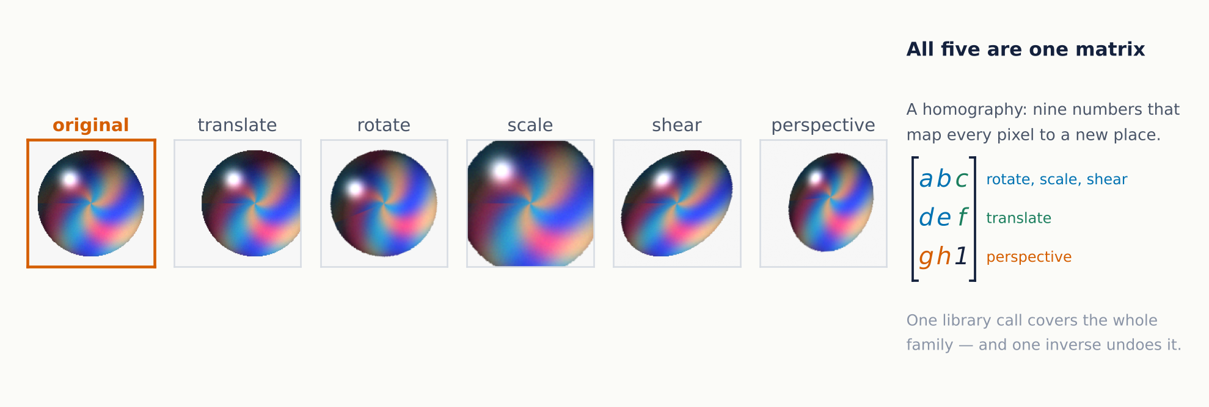
All the geometry is one piece of mathematics
METHOD 5 OF 7 · HOMOGRAPHY
Translation, rotation, scaling, shear and perspective are all the same 3 × 3 matrix with different entries. That is why one library call covers them, and why one inverse undoes any of them.
Notes:
The physical picture is a camera and a flat photograph in three-dimensional space: move the camera and the image you capture is warped by a homography. Perspective is the one students have not usually met — it is what simulates photographing the subject off-axis. OpenCV's documentation on findHomography has the derivation if anyone wants it.

Slide 10
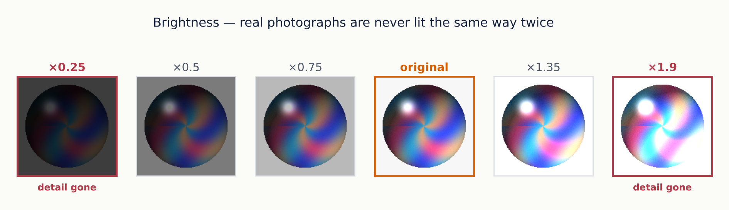
Stop moving the image, start changing the pixels
METHOD 6 OF 7 · BRIGHTNESS
The most realistic augmentation on the list. Unless the photographs were taken under studio lighting, illumination is the thing that varies most between training day and deployment day.
Notes:
A good place to connect to their own work: an in-line camera on a process line sees different light in the morning and at night, and after someone replaces a lamp. Brightness augmentation is how you stop a classifier silently degrading in week three. The limit is the same as everywhere else — once the image is crushed to black or blown out to white, the detail that carried the label is gone.

Slide 11
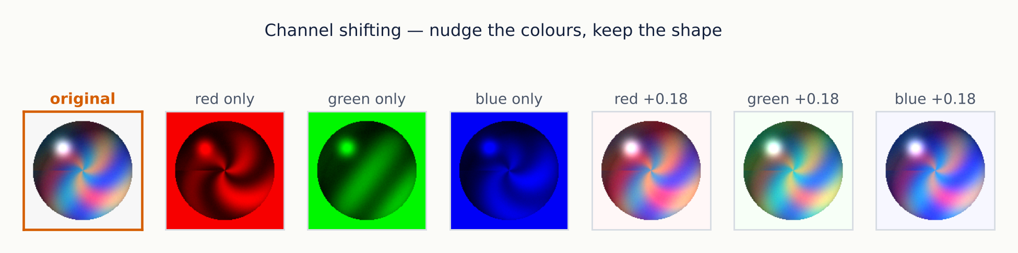
A colour image is three images stacked
METHOD 7 OF 7 · CHANNEL SHIFT
Red, green and blue each hold their own value at every pixel. Nudge one channel and the colour balance shifts while the shape is untouched — which is exactly what a different camera or a different white balance does.
Notes:
Connect this back to the CNN session: with three channels each filter becomes 3 by 3 by 3 and sums across the colours, so a colour image costs three times the filter weights, not three times the network. Then the caution: for anything where colour carries the label — ripeness, a colour-change indicator, a stained sample — channel shifting destroys the signal. It is one of the easiest augmentations to misapply.

Slide 12
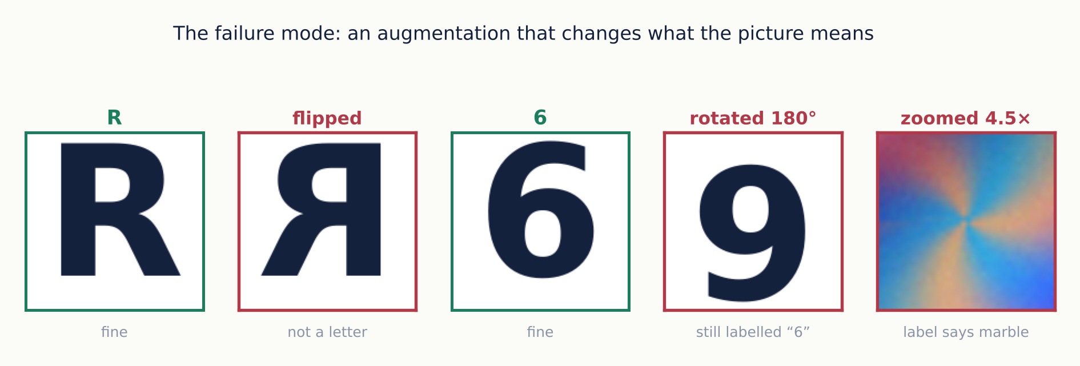
Every augmentation is a claim about the label
THE ONE FAILURE MODE
Flipping an R gives something that is not a letter. Rotating a 6 gives a 9 that is still labelled 6. Both put a wrong answer into the training set, and the model has no way to know.
Notes:
The rotated 6 is the sharpest example because nothing looks broken — the image is clean, it is simply labelled incorrectly. Wrong labels are worse than no labels, and an augmentation pipeline can manufacture thousands of them overnight without a single error message. Always sample the output and look at it.

Slide 13
The same operation, three different verdicts
CHOOSING
Augmentation | Hand signs | Handwritten digits | Micrographs of a film
Horizontal flip | Yes — signs mirror for left-handers | No — a flipped 2 is not a 2 | Yes — no preferred direction
Rotate 180° | No — nobody signs upside down | No — 6 becomes 9 | Yes — the sample has no top
Small rotation | Yes — posture is never identical | Yes — handwriting slants | Yes
Brightness | Yes — room lighting varies | Mild only — ink contrast matters | Careful — intensity may be the measurement
Channel shift | Yes | Not applicable — greyscale | No if colour carries the result
The question is never “is this augmentation good?” but “does my label survive it?”
Notes:
Have them fill in a fourth column for their own project data before the lab. It takes two minutes and it is the single most valuable thing they can do before writing any augmentation code. The micrograph column is the one closest to their own work: intensity in a scientific image is often a measured quantity, not an artefact of lighting, and augmenting it away destroys the signal.

Slide 14
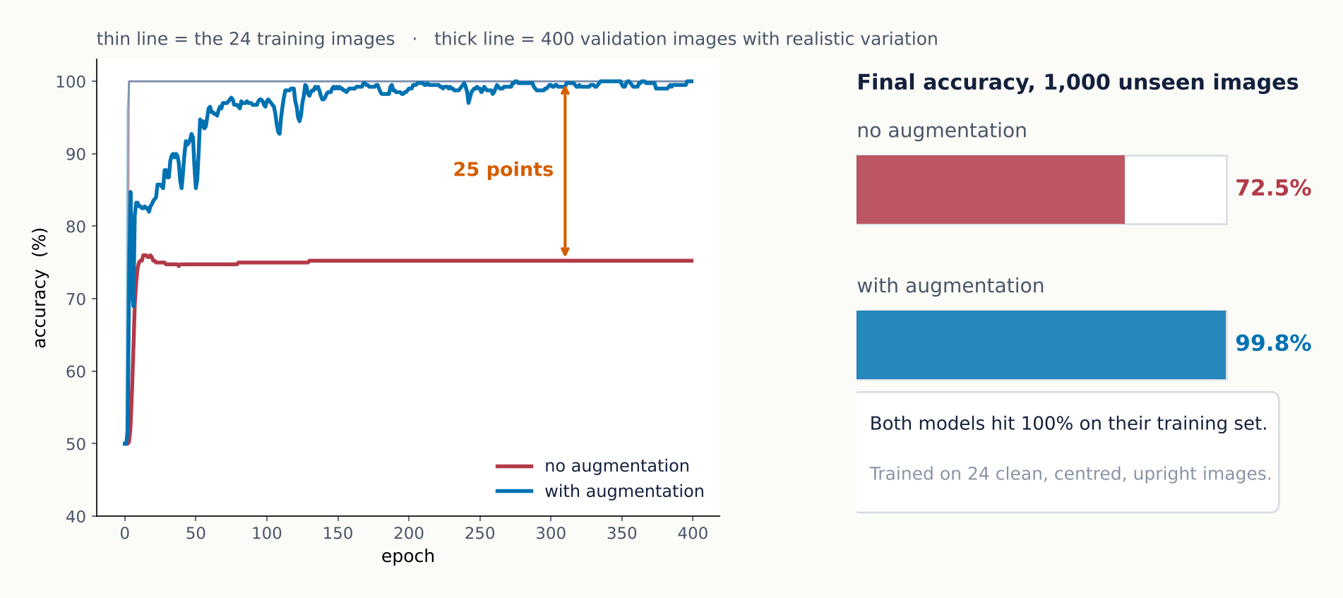
72.5 % to 99.8 %, no new labelled images
DOES IT ACTUALLY WORK
Two identical networks, the same 24 clean training images. One saw them as they were; the other saw a randomly transformed version each epoch. Both memorised the training set perfectly — only one learned the category.
Notes:
Worth saying plainly that this is a deliberately simple two-class task, so the absolute numbers are flattering. The 27-point gap is the finding, not the 99.8. The mechanism is the thing to stress: augmentation did not make the model better at its training data, which was already perfect. It changed what the model had to learn in order to achieve that.

Slide 15
Seven methods, one Compose
IN CODE
RandomHorizontalFlip — flipping, half the time
import torchvision.transforms.v2 as T
RandomRotation(15) — up to ±15°, not 180°
train_tf = T.Compose([
RandomResizedCrop — zoom and shift together, which is why it leaves no blank edges
T.RandomHorizontalFlip(p=0.5),
T.RandomRotation(15),
ColorJitter — brightness here; it also takes contrast, saturation and hue for channel shifting
T.RandomResizedCrop(28,
scale=(0.8, 1.0), antialias=True),
T.ColorJitter(brightness=0.3),
Every number above is a judgement about your data, not a default to accept.
T.ToImage(),
T.ToDtype(torch.float32, scale=True),
Applied by the DataLoader, so it is re-rolled every epoch.
])
Notes:
Two practical notes. The transform goes on the dataset, and the DataLoader calls it each time an image is drawn, so the randomness is fresh every epoch rather than fixed once. And ToImage followed by ToDtype with scale=True is the modern v2 replacement for ToTensor, which is deprecated — their notebooks may still show the old form.

Slide 16
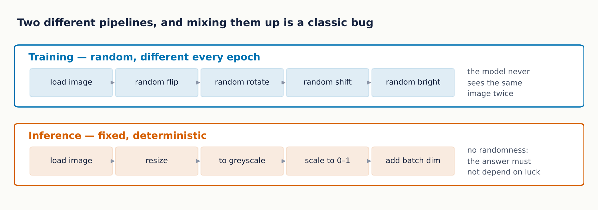
Never augment the data you predict on
TRAINING VERSUS DEPLOYMENT
Augmentation exists to vary the training set. At prediction time the user's image needs reshaping to what the model expects — resize, greyscale, scale to 0–1, add the batch dimension — and nothing random.
Notes:
This is where the NVIDIA deck turns to deployment, and the two topics belong together. A model trained on (1, 28, 28) greyscale will be handed a (3, 287, 433) colour photograph in production, so the fixed preprocessing is not optional. The classic bug is reusing the training transform at inference, which makes the same image give different answers on different calls. If anyone asks about test-time augmentation — averaging predictions over several augmented copies — it is a real technique, but it is a deliberate ensemble, not this.

Slide 17
Four questions before you write any of it
A METHOD FOR CHOOSING
01
02
03
04
What varies in the real system?
Does the label survive it?
Is the signal a measurement?
Can you still read the output?
Lighting, camera angle, sample placement, operator. Augment those, at the strength they actually occur.
If a transformed image would get a different label from a human expert, it must not go in the training set.
In scientific images intensity, scale and colour are often the quantity itself. Augmenting them away deletes the data.
Sample twenty augmented images and look at them. Anything you cannot classify yourself is noise with a label on it.
Augmentation never adds information. It tells the network which changes it should ignore — and if you tell it to ignore something that mattered, you have made the model worse in a way the training curve will not show you.
Notes:
The last sentence is the one to leave them with. A bad augmentation choice does not raise an error and does not hurt training accuracy; it quietly costs you validation performance, and the only way to catch it is to think about the labels beforehand and look at the images afterwards.

Slide 18
What to remember
FIVE THINGS TO TAKE AWAY
01
02
03
04
05
A large train-validation gap is a data problem more often than a model problem.
Geometry — flip, rotate, zoom, shift, shear, perspective — is all one matrix.
Brightness and channel shift change pixel values rather than pixel positions.
Every augmentation claims the label still holds. A wrong claim poisons the data silently.
Random at training time, fixed at prediction time. Never the other way round.
FOLLOWS
TO TRY
NVIDIA DLI, Fundamentals of Deep Learning, Part 4 — the seven methods are theirs; the measurements are ours
Before the lab, write down which of the seven your own project images can survive — and which would change the answer.
Notes:
End on takeaway four. The students most likely to over-augment are the ones most pleased with how easy it is, and a silently poisoned training set is the expensive mistake in this topic.

